Slide 1
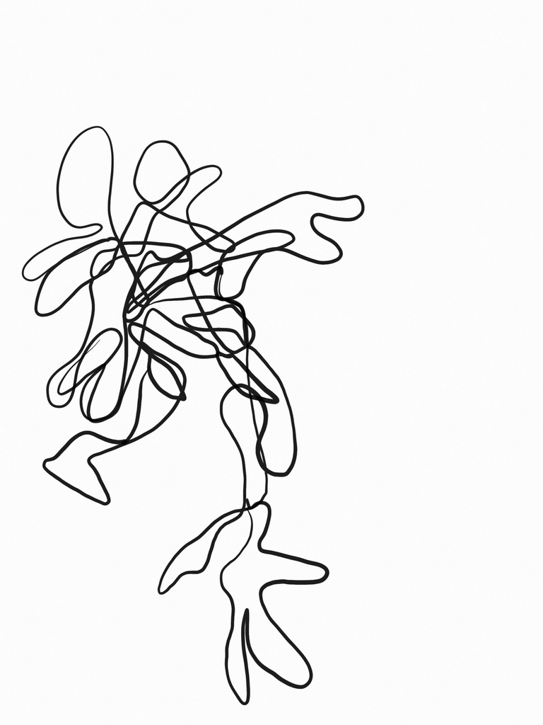
Becoming sensitive research instruments
Ulrike Scholtes – PhD - she/her
Research Centre What Art Knows
MERIAN
Zuyd – UvA
www.ulrikescholtes.de
Artistic research Bodily knowledge – embodied methods
Embodied labour in arts education
& art-science crossovers

Slide 2
“Embodied knowledge” through material-semiotic lens (Feeling Techniques, Embodied exercises in art education)
Art-science “collaborations” with a focus on embodied invisible labour.
The researcher as sensitive research instrument:
Interdisciplinary art and performance
Feeling Science with Ellen Algera and Sonja Jerak-Zuiderent

Slide 3
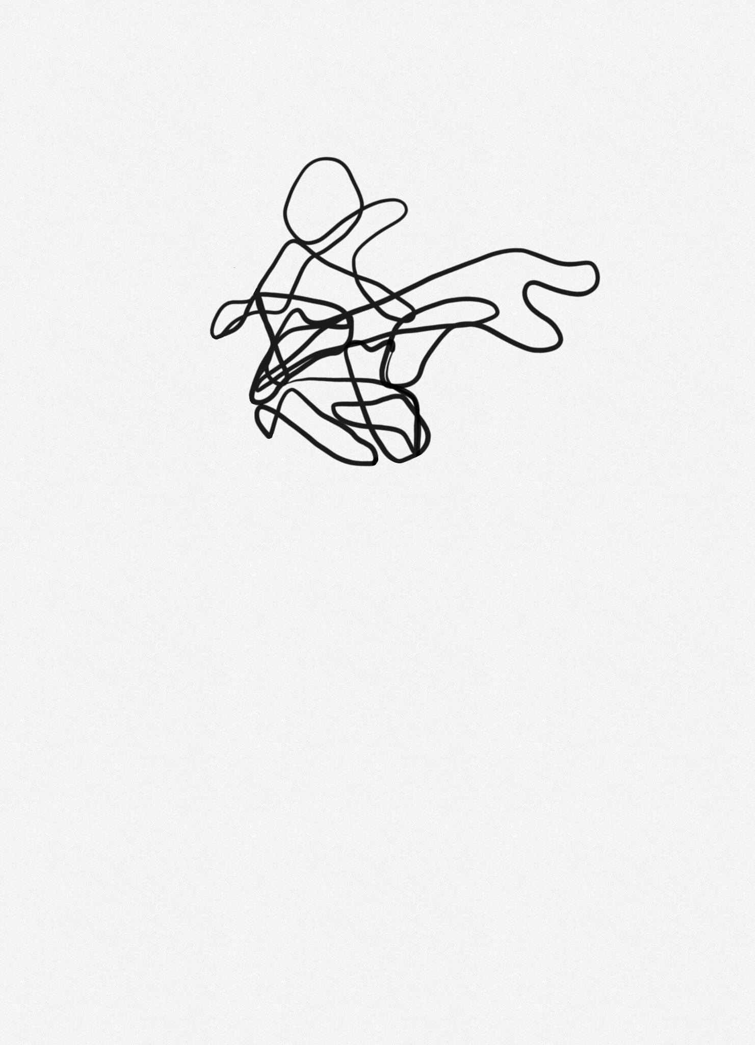
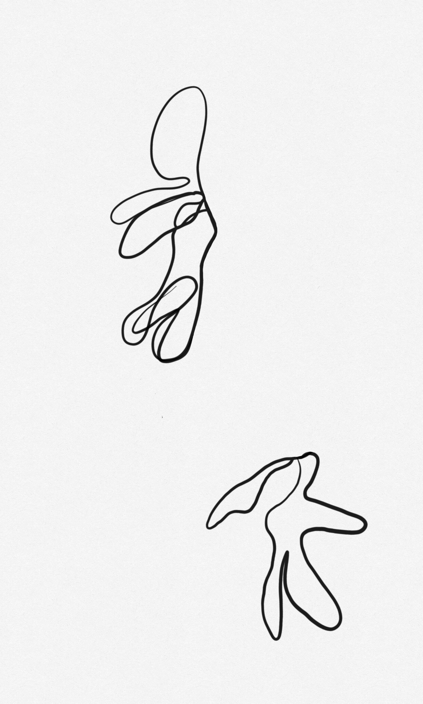
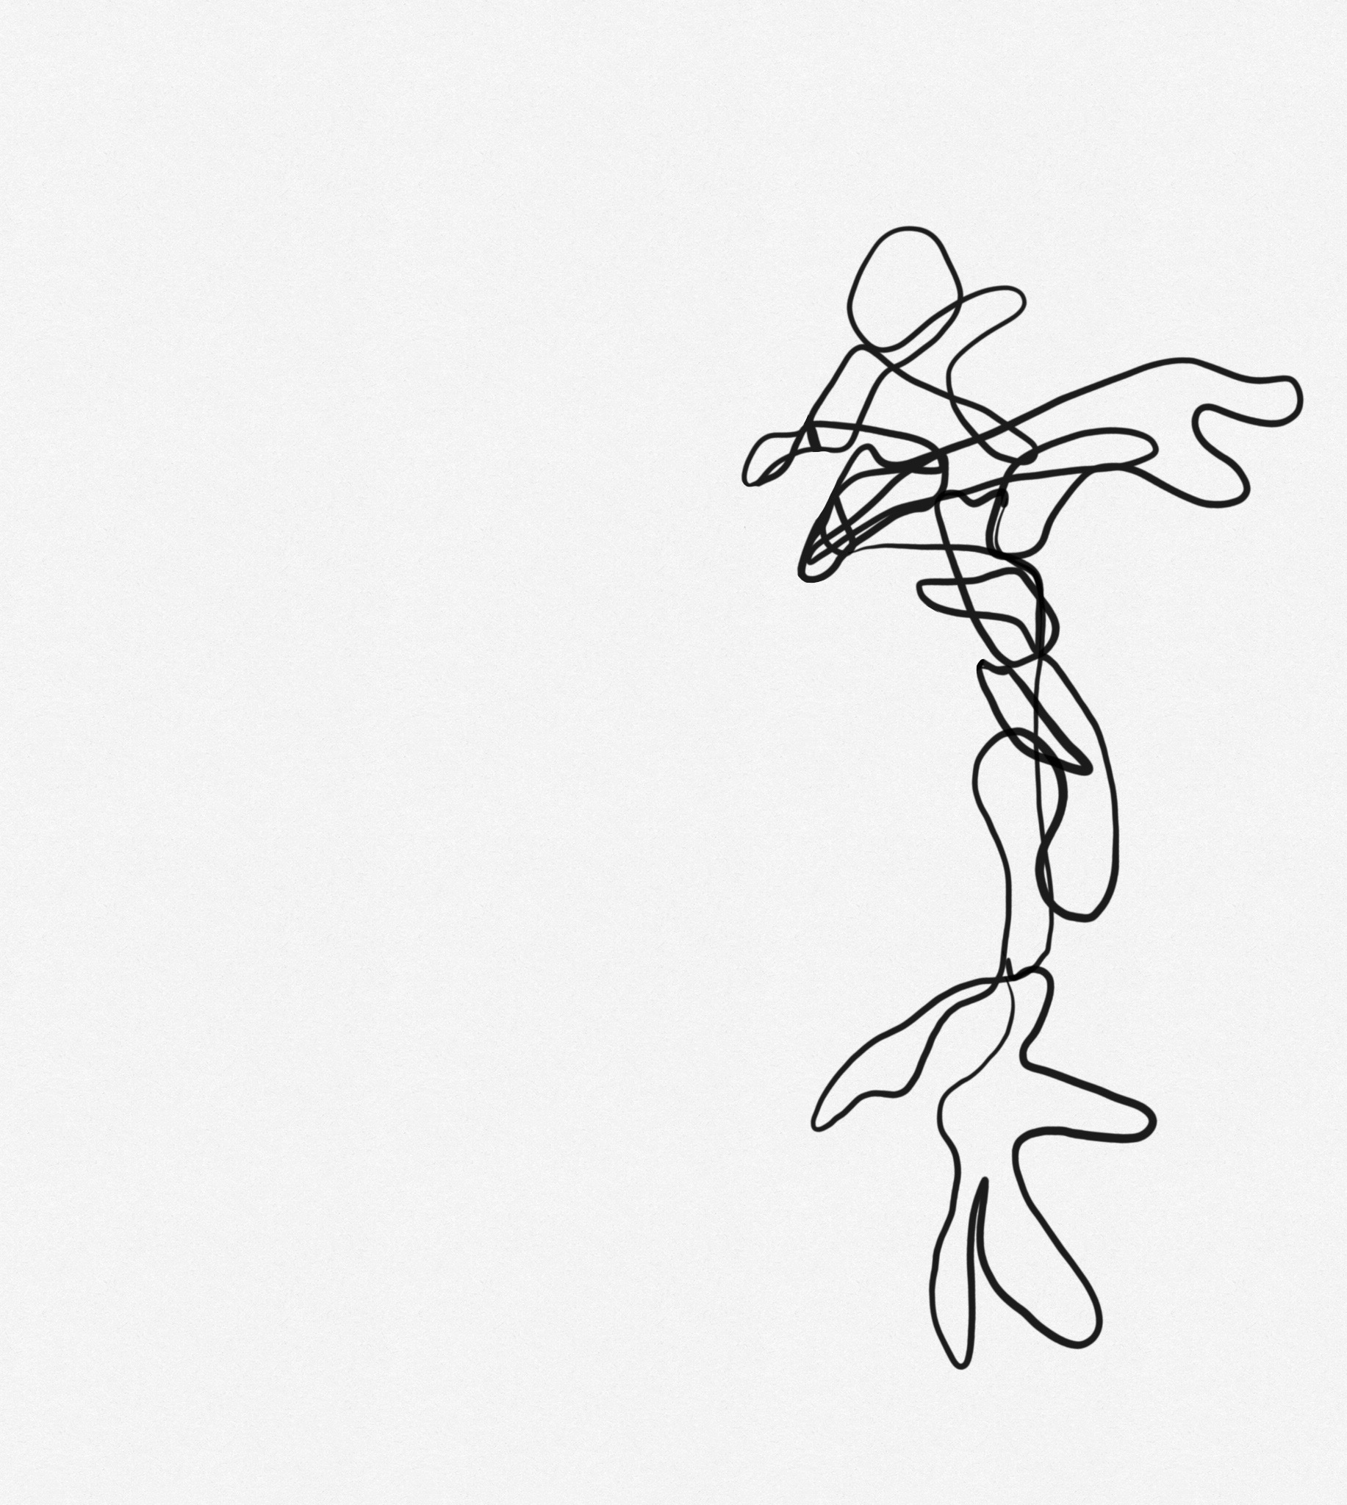
Group 1:
Bodies
relating to objects
Group 2:
Bodies
relating to spaces
Group 3:
Bodies
relating to other
bodies

Slide 5
Part 1: (researching) bodies in relation with objects.
GROUP 1: Works with tools to become aware of body in relation to objects.
GROUP 2: While in relation to objects, observes, documents, researches: how do these bodies relate to objects?
GROUP 3: How do these researchers relate to objects?
Part 2: (researching) bodies in relation with spaces
GROUP 2: Works with tools to become aware of body in relation with space.
GROUP 3: While in relation with space, observes, documents, researches: how do these bodies relate to space?
GROUP 1: How do these researchers relate to space?
Part 3: (researching) bodies in relation with other bodies.
GROUP 3: Works with tools to become aware of body in relation with other bodies
GROUP 1: While in relation to other bodies, observes, documents, researches: how do these bodies relate to other bodies?
GROUP 2: How do these researchers relate to other bodies?

Slide 6

DISCUSSION
How does the body become a research instrument in relation to
objects
spaces
Other (human and more-than-human) bodies
How to teach students to become sensitive research instruments?

Slide 7
LITERATURE
Scholtes, U. (2022) Feeling Techniques – Making methods to articulate bodily practices. University of Amsterdam
Fox Keller, E. (1984). A Feeling for the Organism: The Life and Work of Barbara McClintock. Henry Holt and Company
Algera, E. (2022) Knowing (with) the body: Sensory knowing in contraceptive self-tracking. Sociology of Health and Illness.
Harris, A. (2020). Introduction. A Sensory Education. Abingdon-on-Thames: Taylor and Francis Ltd., 1-23
Myers, N. (2008). Molecular Embodiments and the Body-Work of Modeling in Protein Crystallography. Social Studies of Science 38(2), 163–99.
Viteritti, A. (2013). It’s the Body (That Does It)! The Production of Knowledge through Body in Scientific Learning Practice. Scandinavian Journal of Management 29(4)
Despret, V. (2004) ‘The Body We Care for: Figures of Anthropo-zoo-genesis’, Body & Society, 10(2–3), pp. 111–134.
Lawrence, Christopher and Steven Shapin (1998). Science Incarnate: Historical Embodiments of Natural Knowledge. Chicago: The University of Chicago Press
Sismondo, Sergio (2009). ‘Feminist Epistemologies of Science’, in: An Introduction to Science and Technology Studies. London, UK: Wiley Blackwell, p. 72- 80.
Vertesi, J. (2012). Seeing like a Rover: Visualization, embodiment, and interaction on the Mars Exploration Rover Mission. Social Studies of Science, 42(3)
Jerak-Zuiderent, S. (2015). Accountability from Somewhere and for Someone: Relating with Care. Science as Culture, 24(4), 412–435.
Byczkowska-Owczarek, D., and Honorata, J. (2018). Sociology of the Body — Teaching Embodied Approach through Autoethnography. Qualitative Sociology Review 14(2), 152–64.
Mialet, H. (2022). Bodies in Balance: Tracking Type 1 Diabetes. Body & Society 28(3), 89-113.
Fitzgerald, D. et al. (2014). Ambivalence, Equivocation and the Politics of Experimental Knowledge: A Transdisciplinary Neuroscience Encounter. Social Studies of Science 44(5), 701–21.
Hillersdal, L., A. P. Jespersen, B. Oxlund, and B. Bruun. (2020). Affect and Effect in Interdisciplinary Research Collaboration. Science and Technology Studies 33(2), 66–82.
Smolka, M., E. Fisher, and A. Hausstein. (2021). From Affect to Action: Choices in Attending to Disconcertment in Interdisciplinary Collaborations. Science Technology and Human Values 46(5), 1076–1103.
Endaltseva, A. and S. Jerak-Zuiderent. (2021). Embodiment work in Ethnographic Collaborations: Composition, Movement, and Pausing within the Multiple Sclerosis Society in Russia. Science & Technology Studies 34(3), 38-45.
Law, J., and W. Lin. (2010). Cultivating Disconcertment. The Sociological Review 58(2), 135–53.
Kimmerer, R. W. (2020). Braiding Sweetgrass: Indigenous Wisdom, Scientific Knowledge and the Teaching of Plants, Penguin Books, 39-47.
Jones, N.L. (2011) “Embodied ethics: from the body as specimen and spectacle to the body as patient.” A Companion to the Anthropology of the Body and Embodiment, Wiley-Blackwell, 72-85
Poldner, K., O. Branzei, and C. Steyaert. (2019). The Embodied Ethics of Entrepreneurial Self-Formation. Organization 26 (2), 151–74.

