Slide 1
What senses?
Sensory Based Learning Symposium
Notes:
Our senses are fascinating features of our nervous system.
They are constantly working together by integrating perceptions from our internal and external environments.
Sensory processing is the organisation of all this sensory information for everyday use. The organisation of sensations for use (Ayres)
Sensory integration processes underlie the development of:
-Self-regulation
-Development of motor and sensory skills
-Development of social and interaction skills
-Sense of self
https://sensoryhealth.org/basic/your-8-senses

Slide 2
THE SENSES
The Unconscious senses
Tactile (touch)
Proprioception
Vestibular
Interoception
The Higher senses
Vision (Visual)
Hearing (Auditory)
Taste (Gustatory)
Smell (Olfactory)
https://sensoryhealth.org/basic/your-8-senses
Notes:
We're all familiar with our common 5 senses...shout out as I point to them?
Then let's demonstrate our 3 more unfamiliar unconscious senses:
WHAT FUNCTIONAL/BEAHVIOURAL ISSUES ARISE WHEN YOUR SENSORY PROCESSING ISN’T INTEGRATING AS IT SHOULD?
Modulation difficulties leads to:
-Over sensitive
-Under sensitive
Body awareness-poor registration and/or poor discrimination leads to:
-Motor planning
-Motor skills
-Executive functioning
-Memory, attention & focus
Bundy et al. (2002) stated this postulate of sensory integration theory as follows: “Learning is dependent on the ability to take and process sensation from movement and the environment and use it to plan and organize behavior” (p. 5).
The hypotheses that Ayres proposed continue to reflect forward thinking about brain function and learning and behavior, such as:
Perceptual awareness supports and facilitates occupational engagement.
Motor learning is influenced by, if not dependent on, incoming sensation.
Body awareness creates a postural model to understand visual-motor development.
Postural control is essential for skilled academic and motor performance.
Tactile, vestibular, proprioceptive, and visual systems provide key data in the development of reading and writing.
The ability to focus and maintain attention and to keep a steady level of activity, and the way in which the nervous system responds to tactile sensation, are related.
The sensory systems develop in an integrated and dependent manner.
Visual and auditory processing depend on foundational body-centered senses.
2

Slide 3
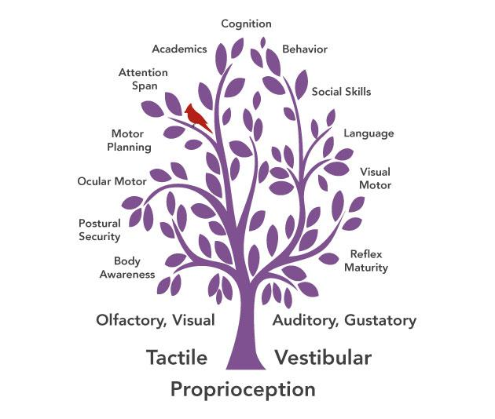
Sensory Integration Foundations for Learning and Behavior
Feed the Roots…
not only the leaves!
Notes:
3
Sensory Systems form the foundation for all learning as normal development follows the progression:
Sensory Motor Development
Perceptual Development
Cognitive Intellect
Sensory integration provides the foundation to work in collaboration with other intervention strategies such as educational models or teaching social understanding as developed by Carol Gray.
Prepares the nervous system to attend and respond

Slide 4
ACTIVITY
Notes:
DEMO:
Tactile (Object in hand/ feely bag)
Proprioception (Draw star in Mirror/ YMCA)
Vestibular (Train moving)
4

Slide 5
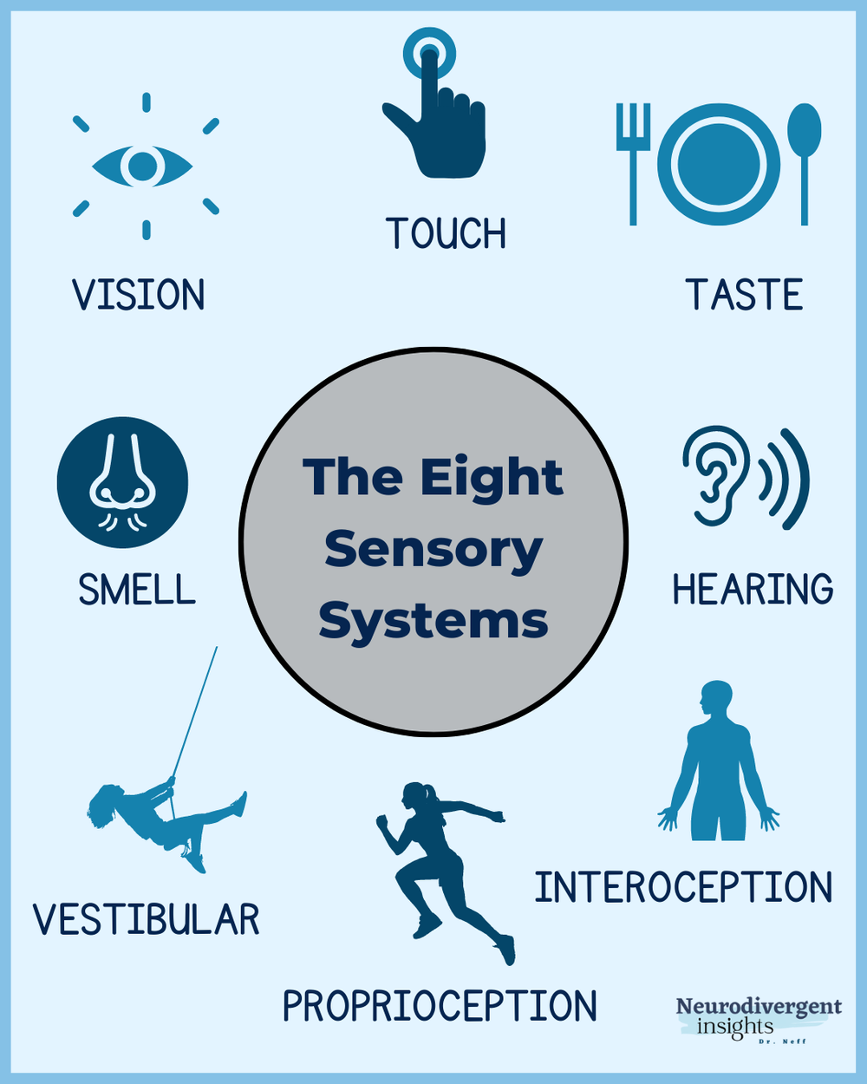
Remember your 8 senses!
Notes:
According to Ayres, sensory information is not processed in isolation and, given this essential feature of the central nervous system, therapeutic intervention that incorporates sensation to affect multisensory perception will influence learning and behavior.
Ayres (1961) proposed that through the development of these sensorimotor functions and, specifically, by facilitating adaptive somatomotor responses, a person can develop improved learning, reading, math, visual and auditory perception, and skilled motor tasks.

